Slide 1

Scrum-Agile methods for Snhu Travel
Enrique Zarate

Slide 2
Scrum-Agile Roles
Product Owner:
Scrum Master
Stake holders
Developer Team
The product owner is responsible for communicating with the stakeholders and organizing the product backlog based on the stakeholders needs.
The stakeholders are those that are financing the project and having the application or software developer in order to make their organization more efficient.
The Scrum Master is responsible for communicating the priorities to the developer team and leading the dev team with scrum events. Mentor role to the dev team.
The Dev team is made up of developers that will work on the program and test it to make sure that it meets the functionality requirements as set by the stakeholders and product owner.

Slide 3
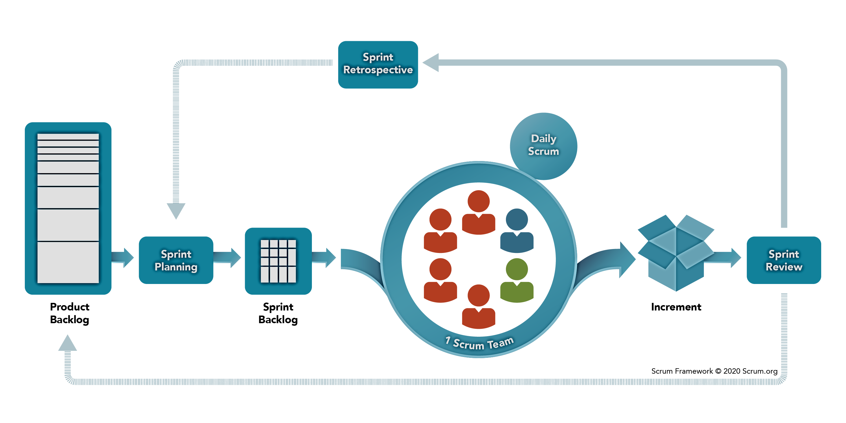
Graphic from Scrum.org
Scrum Framework

Slide 4
Step 1: The product owner works with the stakeholders to identify user stories and create a product backlog that will give the development team an organized itemized list of applications or requirements that need to be met.

Slide 5
Step 2: The whole team meets to plan out the sprint that generally last 1-4 weeks to notify the product owner what from the product backlog can be completed before the end of the sprint. This allows the developers to realistically discuss what are realistic timelines for completions.

Slide 6
Step 3: Throughout the sprint, daily meetings are held in order to update the rest of the team where they are at with their current assignments to allow transparency and creativity to flow especially if there are impediments for specific team members. By the end of the sprint, different portions of the desired program have been built and can be passed to stake holders for updates.

Slide 7
Step 4: The team meets to go over what was achieved and what were any primary obstacles in the way of the Scrum team to allow for the team to keep evolving and learning from previous assignments. This is the chance to identify areas of improvement.

Slide 8
Step 5: If any new information has arisen from the stake holders, the product backlog can be updates and changed to reflect any new information so that the team can receive the updates in the next sprint. The cycle is then repeated until a fully developed product is completed and meets all of the stake holders requirements.

Slide 9
Key Differences between Waterfall and Scrum-Agile for SNHU Travel Project
Waterfall
Scrum-Agile Method
Planning period would have been much more extensive.
Fully developed product generally delivered to stake holders before feedback can be received.
Testing usually occurs at the end of the process which is the worst time to have it occur since development is technically considered done at this point and developers are likely to have moved on to other projects.
Allows for changes to be made during development IF any known changes or any new information arises from stake holders.
QA is integrated into multiple steps of the development process rather than having it last.
Transparent communication among all of those on the team.

Slide 10
SNHU Impediments that may have been more serious under Waterfall Methods
Stakeholders decided to pivot to focus on wellness destinations as new trends emerged.
Under a waterfall method, this may have not been accounted for until the completion of the current project which may have resulted in wasted time on a product that is not what the stake holders wanted.
Allowed flexibility with assignments and projects done daily as exemplified through daily scrum meetings.
Chada Tech has some issues with certain developers being specialized in certain areas. The daily scrum meetings allows creativity between team members to help each other when impediments exist. Under waterfall methods, generally each part of the development process happens independently and when their portion is done with the project, they pass it on and communication is generally one way.

Slide 11
When to choose Waterfall vs Scrum-Agile?
When Waterfall is preferred?
Projects with concrete timelines. (Project Management, 2021)
Major project constraints are documented and well understood. (Project Management, 2021)
Technology being used is well understood. (What is Waterfall, 2021)
Shorter projects. (What is Waterfall, 2021)
When Agile is preferred?
Constraints are not well understood. (Project Management, 2021)
Development of a new type of product that has not been created before. (What is Waterfall, 2021)
More suitable for project requirements that may not be stable or at high risk for changing. (What is Waterfall, 2021)
More complex programs that are object-oriented. (What is Waterfall, 2021)

Slide 12
References
Cobb, C.G. (2015) The Project Manager’s Guide to Mastering Agile: Principles and Practices for an Adaptive Approach. Hoboken, NJ: John Wiley & Sons.
Project Management: FAQ (2021, June 20) Wrike. Retrieved from https://www.wrike.com/project-management-guide/faq/when-to-use- agile-vs-waterfall/
What is Scrum? (2021, June 20) Scrum.Org The Home of Scrum Retrieved from https://www.scrum.org/resources/what-is-scrum
What is Waterfall model- Examples, advantages, disadvantages & when to use it? (2021, June 20) Try QA. Retrieved from http://tryqa.com/what-is-waterfall-model -advantages-disadvantages-and-when-to-use-it/

